Slide 1
DATA HIDING IN AN IMAGE FOR SECRET COMMUNICATION
GUIDE
Dr.K.Sangeetha M.E.,Ph.D., Associate Professor
PRESENTED BY :
Nivedha U(211419104185)
Divya S(211419104072)

Slide 2
INTRODUCTION
Steganography is the process of hiding information.
The steganography is made up of three components: the cover medium, the hidden message and the key.
The cover medium carries the information to be hidden.
The hidden message is the message to be hidden.
The key is something like a password.
Cover medium + hidden data + stego key = stego medium
The message is hidden behind a file and a key is generated and the third party person will not have the knowledge about the hidden data or its existence.

Slide 3
LITERATURE SURVEY
YEAR OF PUBLISHING | AUTHOR | TITLE OF THE PAPER | MERITS | DEMERITS
2020 | Kriti Bansal, Aman Agarwal, Nency Bansal | A Survey on Steganography using Least Significant bit (LSB) Embedding Approach | Discusses about almost all types of media to hide images. | Does not provide a particular method that ensures security.
LINK : https://ieeexplore.ieee.org/document/9142896

Slide 4
LITERATURE SURVEY
YEAR OF PUBLISHING | AUTHOR | TITLE OF THE PAPER | MERITS | DEMERITS
2019 | Touhid Bhuiyan, Afjal H. Sarower, , Rashed Karim,Maruf Hassan | An Image Steganography Algorithm using LSB Replacement through XOR Substitution | Provides a method which ensures greater security. | Has only small differences of performance measure.
LINK : https://ieeexplore.ieee.org/document/8938486/metrics#metrics

Slide 5
LITERATURE SURVEY
YEAR OF PUBLISHING | AUTHOR | TITLE OF THE PAPER | MERITS | DEMERITS
2020 | Sabyasachi Pramanik, Debabrata Samanta, Soumi Dutta, Ramkrishna Ghosh, Mangesh Ghonge, Digvijay Pandey | Steganography using Improved LSB Approach and Asymmetric Cryptography | Provides a method which ensures greater security. | It is a complex method.
LINK : https://ieeexplore.ieee.org/document/9398408

Slide 6
LITERATURE SURVEY
YEAR OF PUBLISHING | AUTHOR | TITLE OF THE PAPER | MERITS | DEMERITS
2021 | SACHIN DHAWAN , CHINMAY CHAKRABORTY,JAROSLAVFRNDA , RASHMI GUPTA , ARUN KUMAR RANA , AND SUBHENDU KUMAR PANI | SSII: Secured and High-Quality Steganography Using Intelligent Hybrid Optimization Algorithms for IoT | Provides a method which ensures greater security. | Uses algorithm that are difficult to understand
LINK : https://ieeexplore.ieee.org/stamp/stamp.jsp?arnumber=9454474

Slide 7
LITERATURE SURVEY
YEAR OF PUBLISHING | AUTHOR | TITLE OF THE PAPER | MERITS | DEMERITS
2020 | XINTAO DUAN , DAIDOU GUO,NAO LIU, BAOXIA LI, MENGXIAO GOU, AND CHUAN QIN | A New High Capacity Image Steganography Method Combined With Image Elliptic Curve Cryptography and Deep Neural Network | Provides a method which ensures greater security. | It is a complex method
LINK : https://ieeexplore.ieee.org/stamp/stamp.jsp?arnumber=9454474

Slide 8
PROBLEM STATEMENT
In this presentation, we present an idea for hiding data behind a file. Different methods of data hiding in spatial domain have been proposed and continue to be improved upon. Among them, the image steganography method is quite simple and the most popular. However, because the existing system is quite simple, compared to the other methods, some of its security issues must be improved upon. This project proposes a highly secured data hiding technique in the spatial domain of image steganography. The proposed scheme takes the message bit and performs XOR operation and, after then, the produced output is embedded within the image. The embedding procedure is done in a way that there will be no sign of original message inside the cover object.

Slide 9
ENVIRONMENT
SOFTWARE
1) Pycharm (or) Visual Studio
2) Python (any version above3.7)
LIBRARIES
1) PIL
2) stepic

Slide 10
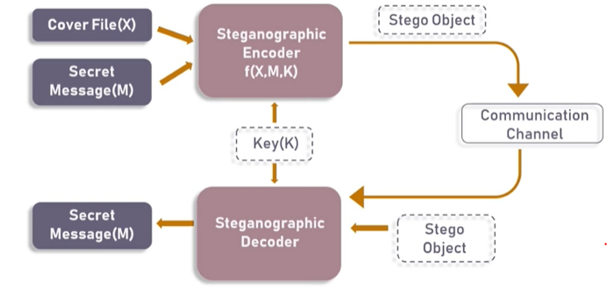
SYSTEM ARCHITECTURE

Slide 11
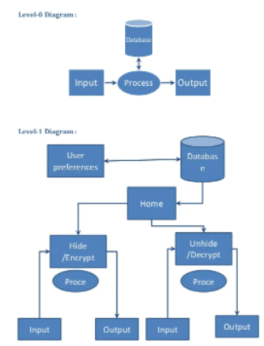
SYSTEM DESIGN - DATA FLOW DIAGRAM

Slide 12
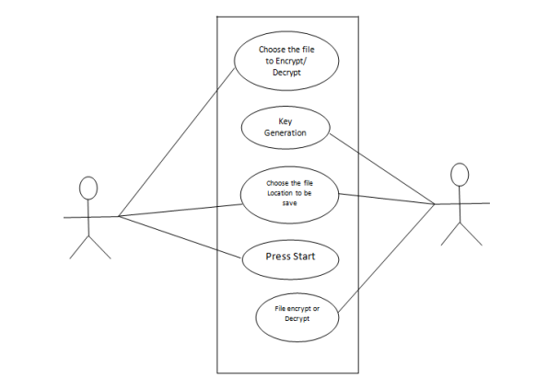
SYSTEM DESIGN
USE CASE DIAGRAM

Slide 13
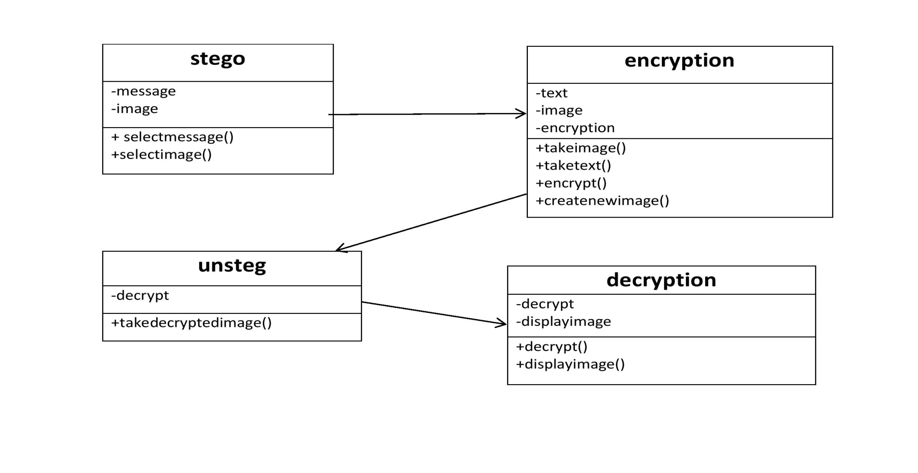
SYSTEM DESIGN
CLASS DIAGRAM

Slide 14
MODULE DESCRIPTION
Converting RGB pixel values to binary.
Converting the message to binary.
Encoding the message.
Decoding the message.

Slide 15
MODULE 1 Converting RGB pixel values to binary
We can describe a digital image as a finite set of digital values, called pixels. Pixels are the smallest individual element of an image, holding values that represent the brightness of a given color at any specific point.
So we can think of an image as a matrix (or a two-dimensional array) of pixels which contains a fixed number of rows and columns.
These pixels will have colors in RGB or RGBA format whose values ranges from 0 to 255.
We convert these values into binary format so that we can insert the message bits in it.

Slide 16
MODULE 2 Convert the message into binary
The message to be converted will be in the form of alphabets.
These alphabets must be converted to binary.
This is done by finding ASCII values(which are in decimal form) for each alphabets.
Then we convert those decimal values into binary

Slide 17
MODULE 3 Encoding the data
The data encoding is done by doing XOR operation between the message bit and the key.
It is then embedded in the image.
Then we name the image with an another name.
It is done with the help of stepic library.

Slide 18
MODULE 4 DECODING THE SECRET MESSAGE
To retrieve the message from the image, it must be decoded.
Using the correct key, the reverse process of encoding is done.
To decode the message, stepic.decode() is used.

Slide 19
PERFOMANCE EVALUATION
For evaluating the performance of encoding and decoding, we use MEAN SQUARE ERROR.
In this, we compare the original image’s pixel array and encoded image’s pixel array.
If the mean square error value is lesser, then the performance is good.

Slide 20
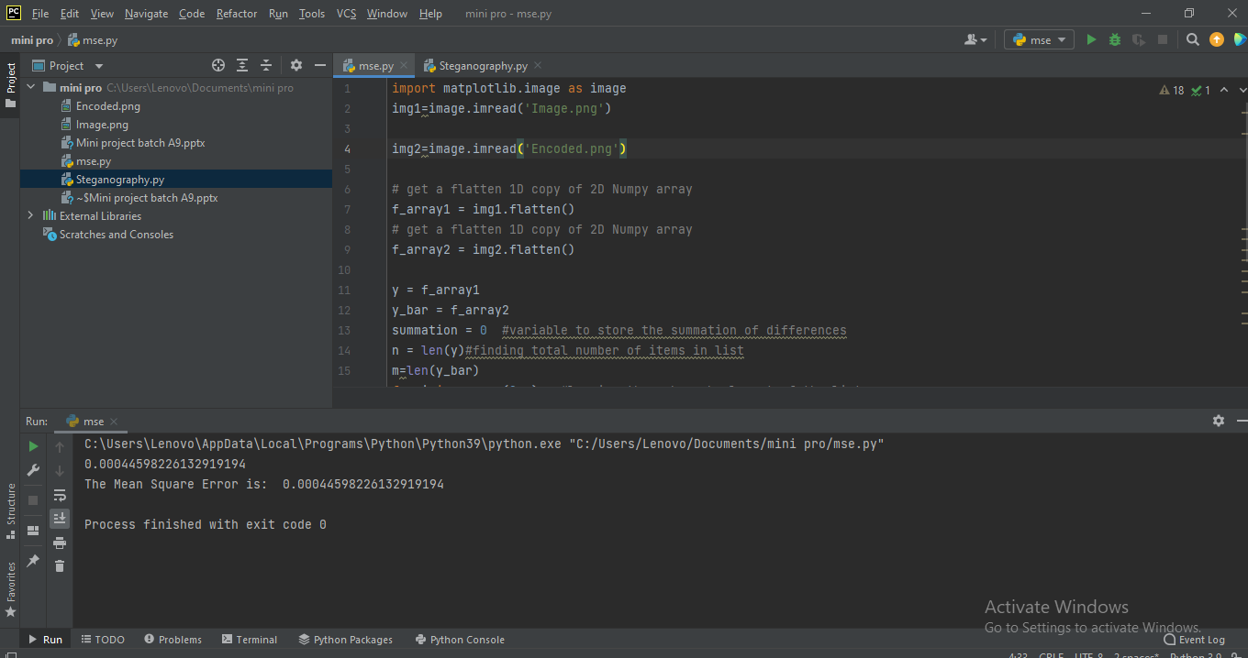
PERFORMANCE EVALUATION

Slide 21
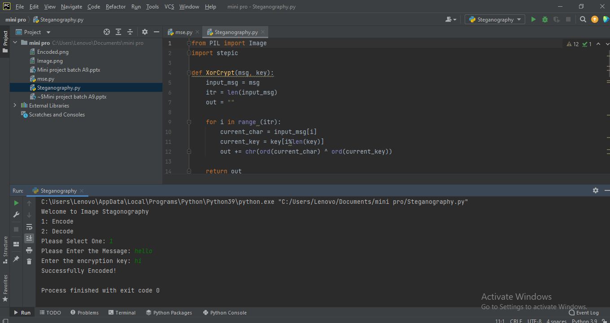
ENCODING

Slide 22
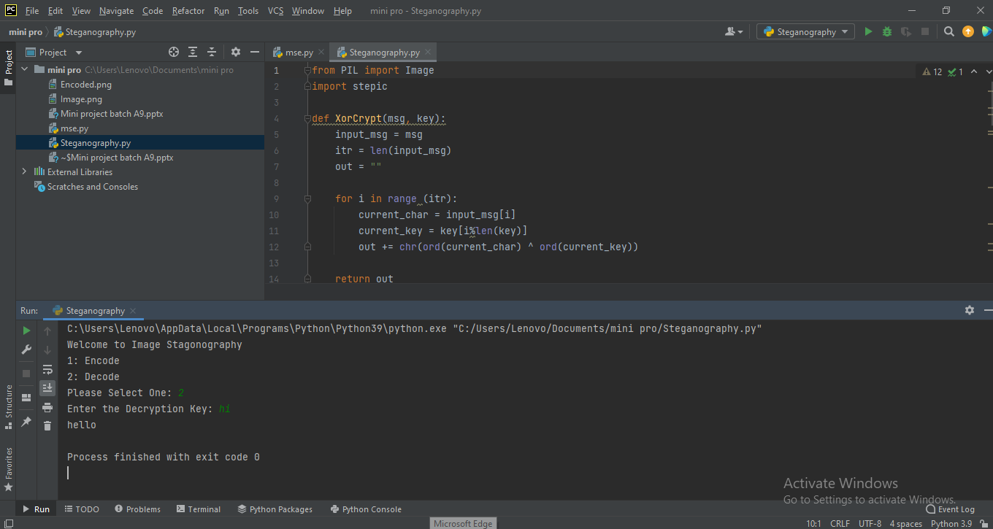
DECODING

Slide 23
CONCLUSION
We have presented a novel steganographic technique for hiding data in a kind of images. The python source code for hiding the image has been developed. However we can change the encoding and decoding methods in order to ensure more secure transfer of the data and also by creating a password. Theoretic analysis and the computing results show that the steganographic system is secure, the embedding capacity is high and the algorithm is practical.

Slide 24
REFERENCES
https://ieeexplore.ieee.org/document/9142896
https://ieeexplore.ieee.org/document/8938486/metrics#metrics
https://ieeexplore.ieee.org/document/9398408
https://ieeexplore.ieee.org/stamp/stamp.jsp?arnumber=9454474
https://ieeexplore.ieee.org/stamp/stamp.jsp?arnumber=9454474
https://ieeexplore.ieee.org/document/7764399

